Slide 1

Japan Shrine & Temple Navigator:
Personalized Guidance with GPT & Interactive Maps
2025/08/22
Advisor：Yi-Chung Chen
Members： Po-Yuan Chu, Bo-Min Zheng

Slide 2

Progress
Edit Mode
Story Mode
Conclusion
This Week's Progress
Intelligent Edit Mode:
Implemented a map editing feature, allowing users to add custom locations.
Custom locations are managed with unique pins and a dedicated filter to achieve map personalization.
Add Story Mode:
Developed an AI travel story generator that creates a travelogue based on the user's itinerary.
Users can build a daily itinerary, upload photos, and edit notes. The final generated story can be downloaded and shared.
Notes:
為大家總結一下本週的進度，我們主要完成了兩大核心功能。
To summarize this week's progress, we have completed two features.
首先，在「編輯模式」中，我們讓使用者能夠在地圖上自由新增並管理自己的私房景點。
First, in "Edit Mode," we enabled users to freely add and manage their own custom spots on the map.
其次，我們新增了「故事模式」，這是一個 AI 功能，可以讓使用者根據他們建立的行程，自動生成一篇個人化的旅遊日誌，並且能輕鬆匯出分享。
"Second, we added 'Story Mode.' It uses AI to turn a user’s trip plan into a personalized travel journal that can be easily shared."

Slide 3
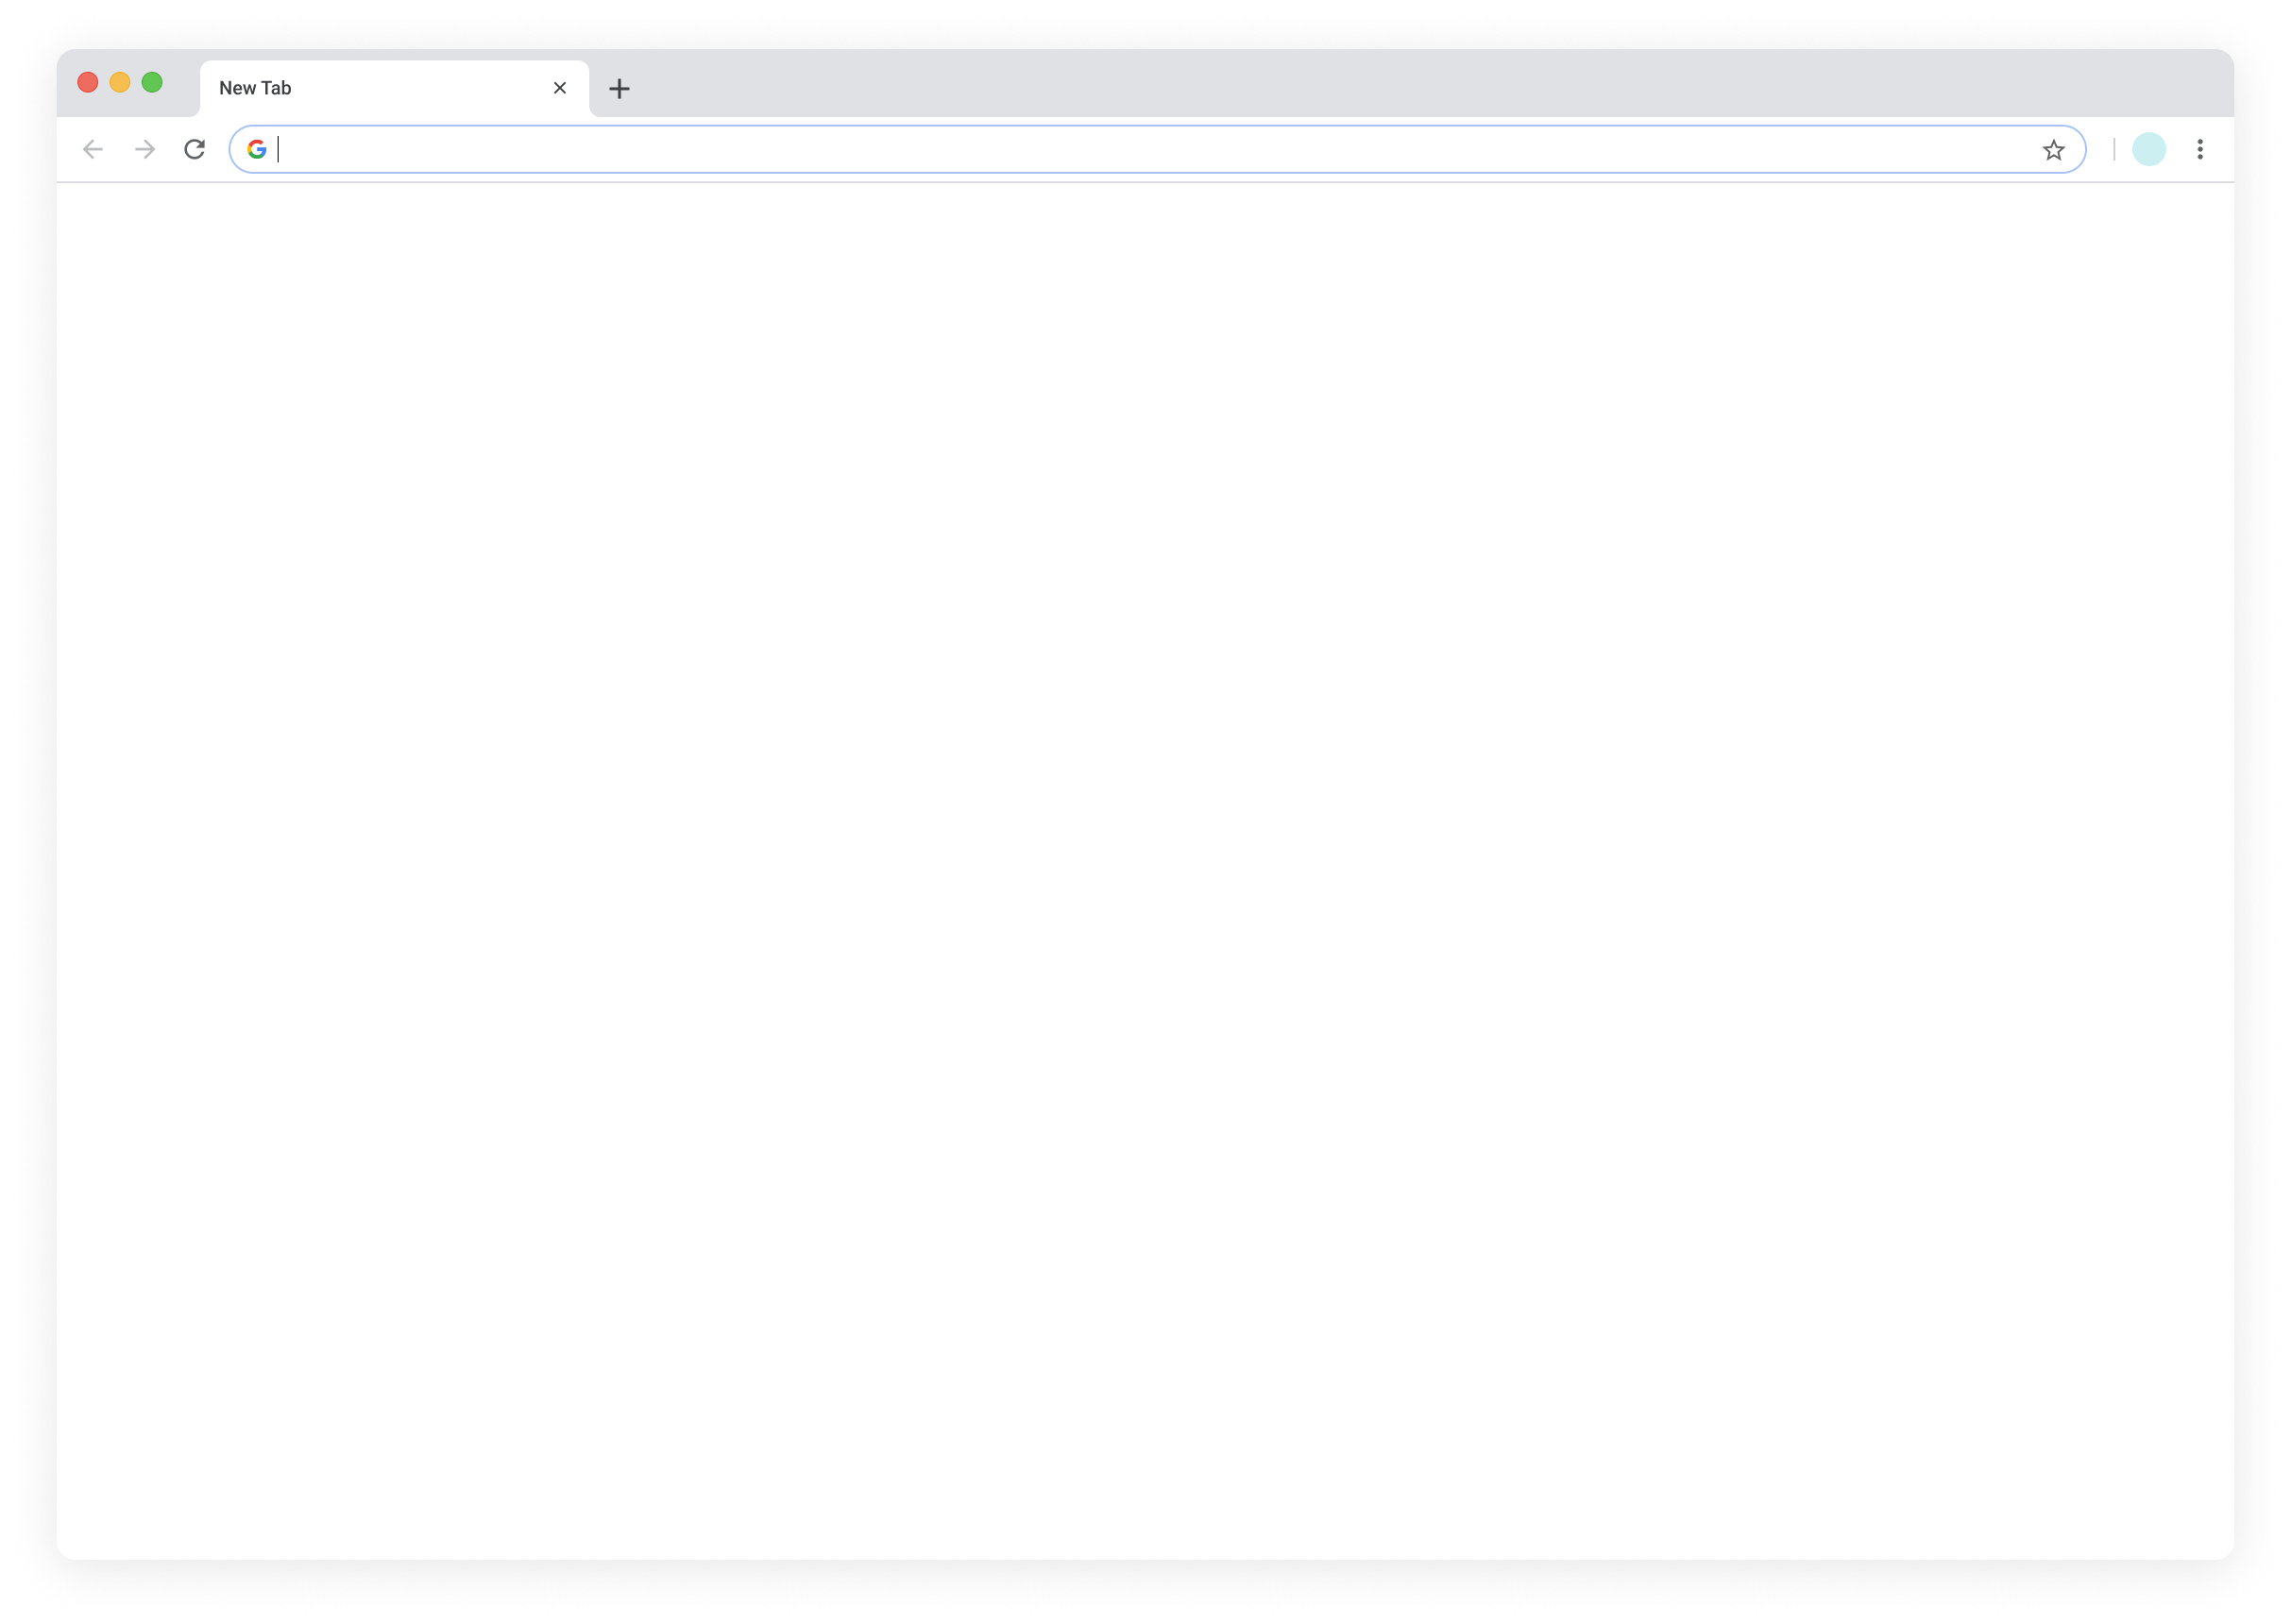
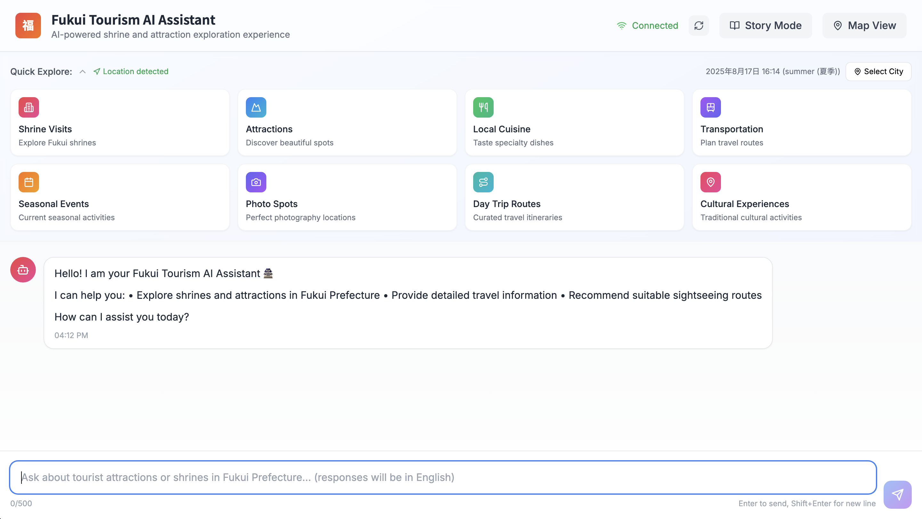
Progress
Edit Mode
Story Mode
Conclusion
User Interface – Edit Mode
Activate Edit Mode
Click the "Map View" button from the main screen to enter the map interface and enable the edit function.
Notes:
好的，我們本週的第一個進度是「編輯模式」，這個功能主要是讓使用者可以自訂地圖上的地點。
Okay, our first update this week is "Edit Mode." This feature allows users to add their own custom locations to the map.
啟用方式很簡單，使用者只要從主畫面點擊右上角的「Map View」，就可以進入地圖。
To activate it, the user simply clicks "Map View" in the top-right corner of the main screen to enter the map.
這裡是編輯流程的入口。
This is the entry point for the editing process.

Slide 4
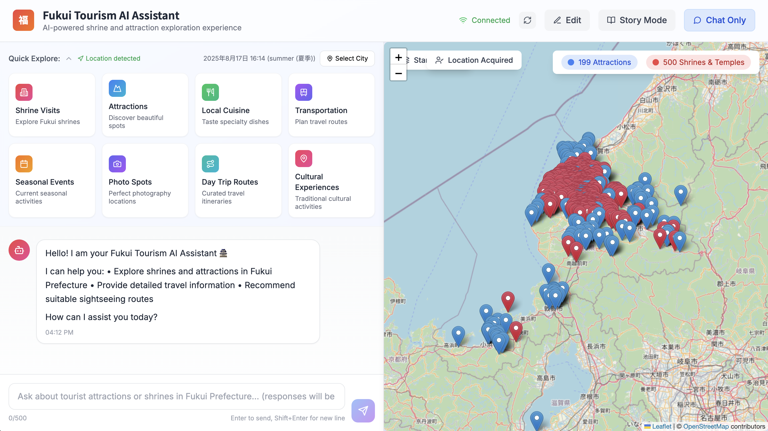
Progress
Edit Mode
Story Mode
Conclusion
User Interface – Edit Mode
Activate Edit Mode
Once in the map interface, click the "Edit" button in the top-right corner to prepare to add a custom location.
Notes:
進入地圖後，大家可以看到右上角的按鈕切換成了「Edit」。
After entering the map, you can see the button in the top-right corner has switched to "Edit."
點擊這個按鈕，我們就正式進入了「編輯模式」。
By clicking this button, we officially enter "Edit Mode."
在這個模式下，使用者就可以開始在地圖上新增自己的地點。
In this mode, the user can now begin adding their own locations to the map.

Slide 5
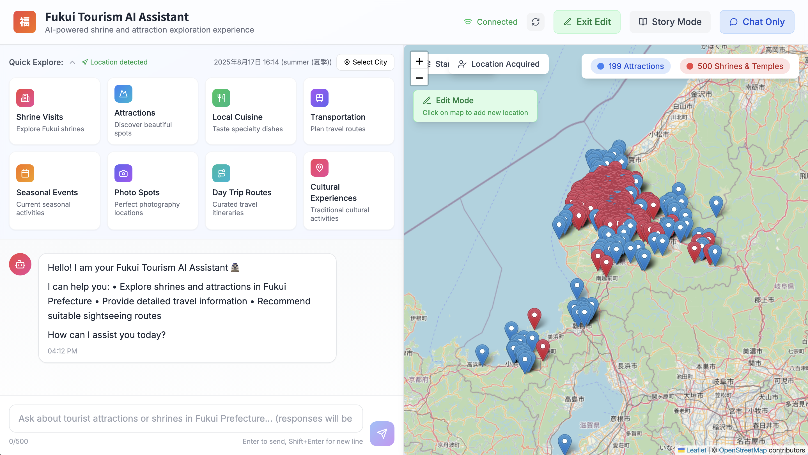

Progress
Edit Mode
Story Mode
Conclusion
User Interface – Edit Mode
Mark a New Location
In Edit Mode, click any position on the map to prepare to add location information.
Notes:
啟動編輯模式後，畫面上會出現提示，引導使用者操作。
Once Edit Mode is active, a prompt appears on the screen to guide the user.
現在，使用者只需要在地圖上點擊任何他想標記的位置。
Now, the user simply needs to click on any position on the map they wish to mark.
這個點可以是任何地方，例如一家不在地圖上的餐廳，或是一個私房景點。
This spot can be anywhere, for example, a restaurant that's not on the map, or a secret spot.

Slide 6
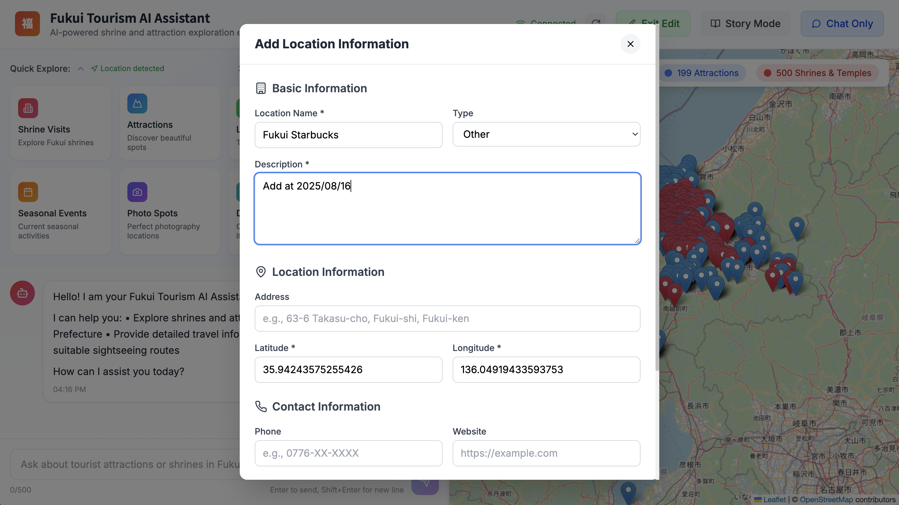
Progress
Edit Mode
Story Mode
Conclusion
User Interface – Edit Mode
Fill in Location Information
After clicking the map, a form pops up for the user to enter the location's name, description, and contact information.
Notes:
點擊地圖後，畫面會彈出一個「新增地點資訊」的表單。
After clicking the map, an "Add Location Information" form appears.
使用者可以在這裡輸入地點的名稱、類型、描述等基本資料。
Here, the user can input the location's basic details, such as its name, type, and description.
值得一提的是，地點的經緯度會根據點擊位置自動填入，簡化了使用者的操作。
"One more thing — the latitude and longitude are filled in automatically when you click, so it’s easier for the user."

Slide 7
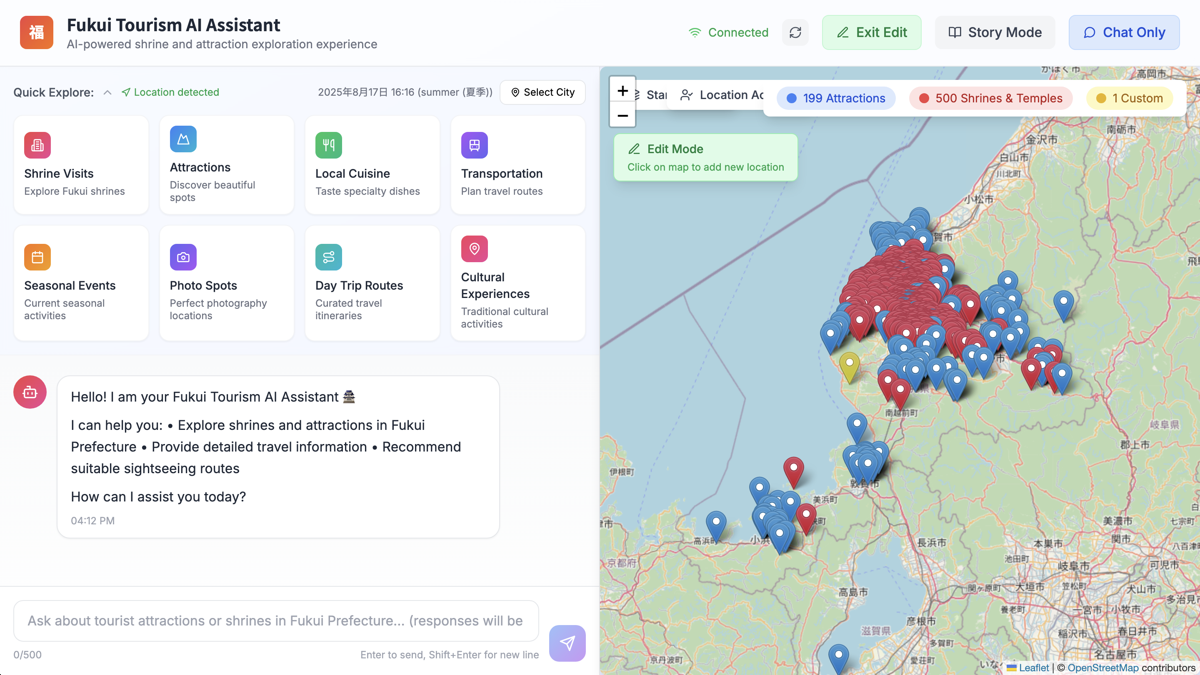
Progress
Edit Mode
Story Mode
Conclusion
User Interface – Edit Mode
Displaying Custom Locations
The new location is marked on the map with a yellow pin and categorized into the "Custom" filter for management.
Notes:
資訊儲存後，新的地點會立刻顯示在地圖上。
After the information is saved, the new location appears on the map instantly.
為了跟內建的景點做出區別，使用者自訂的地點會統一用黃色圖釘來標示。
To distinguish them from built-in points of interest, user-added locations are marked with a yellow pin.

Slide 8
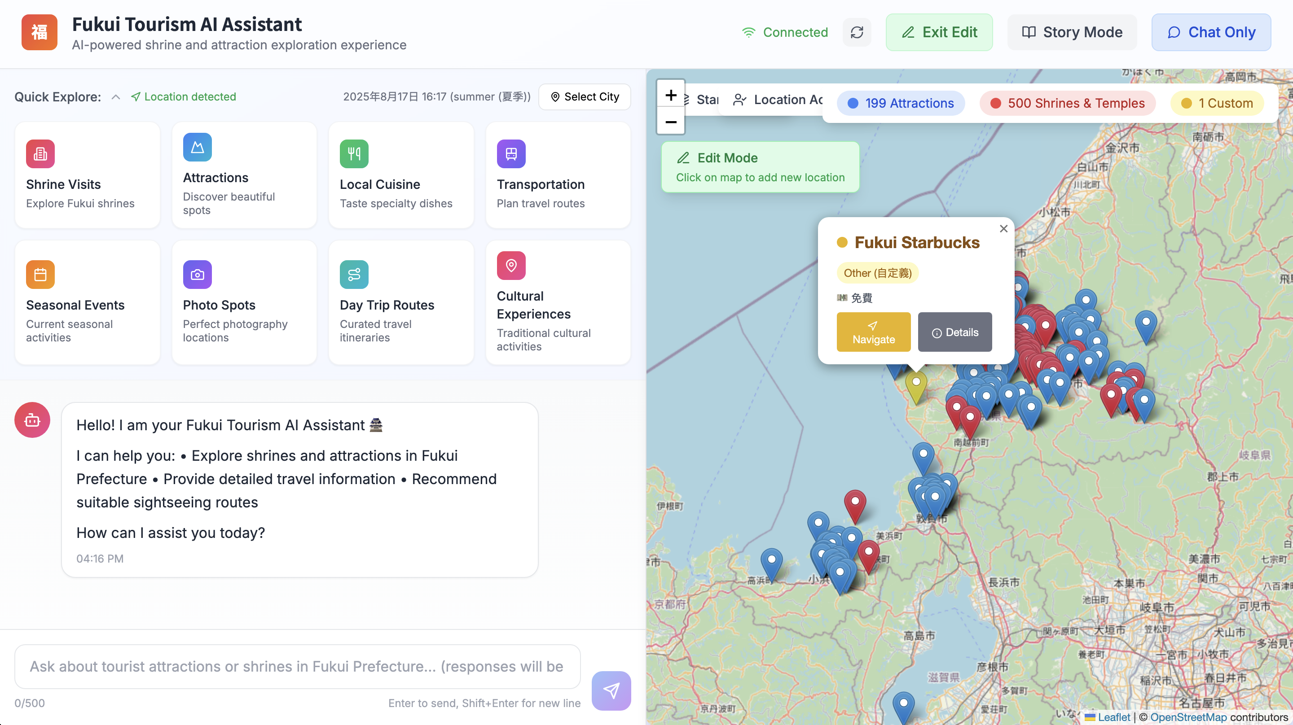
Progress
Edit Mode
Story Mode
Conclusion
User Interface – Edit Mode
Displaying Custom Locations
The new location is marked on the map with a yellow pin and categorized into the "Custom" filter for management.
Notes:
同時，上方的篩選器也會出現一個「Custom」的分類，方便使用者管理這些自訂的點位。
A "Custom" category also appears in the top filter, allowing users to manage these custom spots easily.

Slide 9
Progress
Edit Mode
Story Mode
Conclusion
User Interface – Story Mode
Activate Story Mode
From the main screen, click the "Story Mode" button to start creating your personal travel story.
Notes:
好的，介紹完編輯模式，現在來看我們第二個主要進度：「故事模式」。
After covering Edit Mode, let's look at our second major update: "Story Mode.”
這個功能可以根據使用者的行程，自動生成一篇旅遊日誌。
This feature automatically generates a travel journal based on a user's itinerary.
要啟用它，使用者同樣是從主畫面右上角點擊「Story Mode」按鈕，進入故事生成器。
To activate it, the user clicks the "Story Mode" button in the top-right corner of the main screen to enter the story generator.

Slide 10
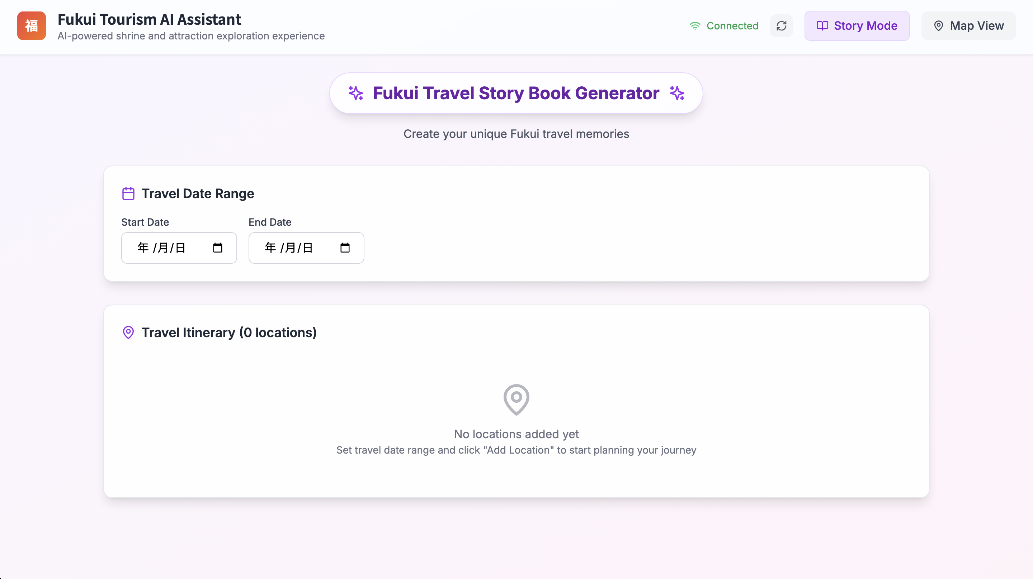
Progress
Edit Mode
Story Mode
Conclusion
User Interface – Story Mode
Set Travel Dates
The user first needs to select the start and end dates for the trip to serve as the time frame for the story.
Notes:
進入生成器後，第一步是設定旅行的日期範圍。
After entering the generator, the first step is to set the date range for the trip.
使用者在這裡選擇開始和結束日期。
The user selects the start and end dates here.
這個日期將會建立出故事的時間主軸，並用來組織接下來的每日行程。
These dates will establish the story's timeline and will be used to organize the daily itinerary that follows.

Slide 11
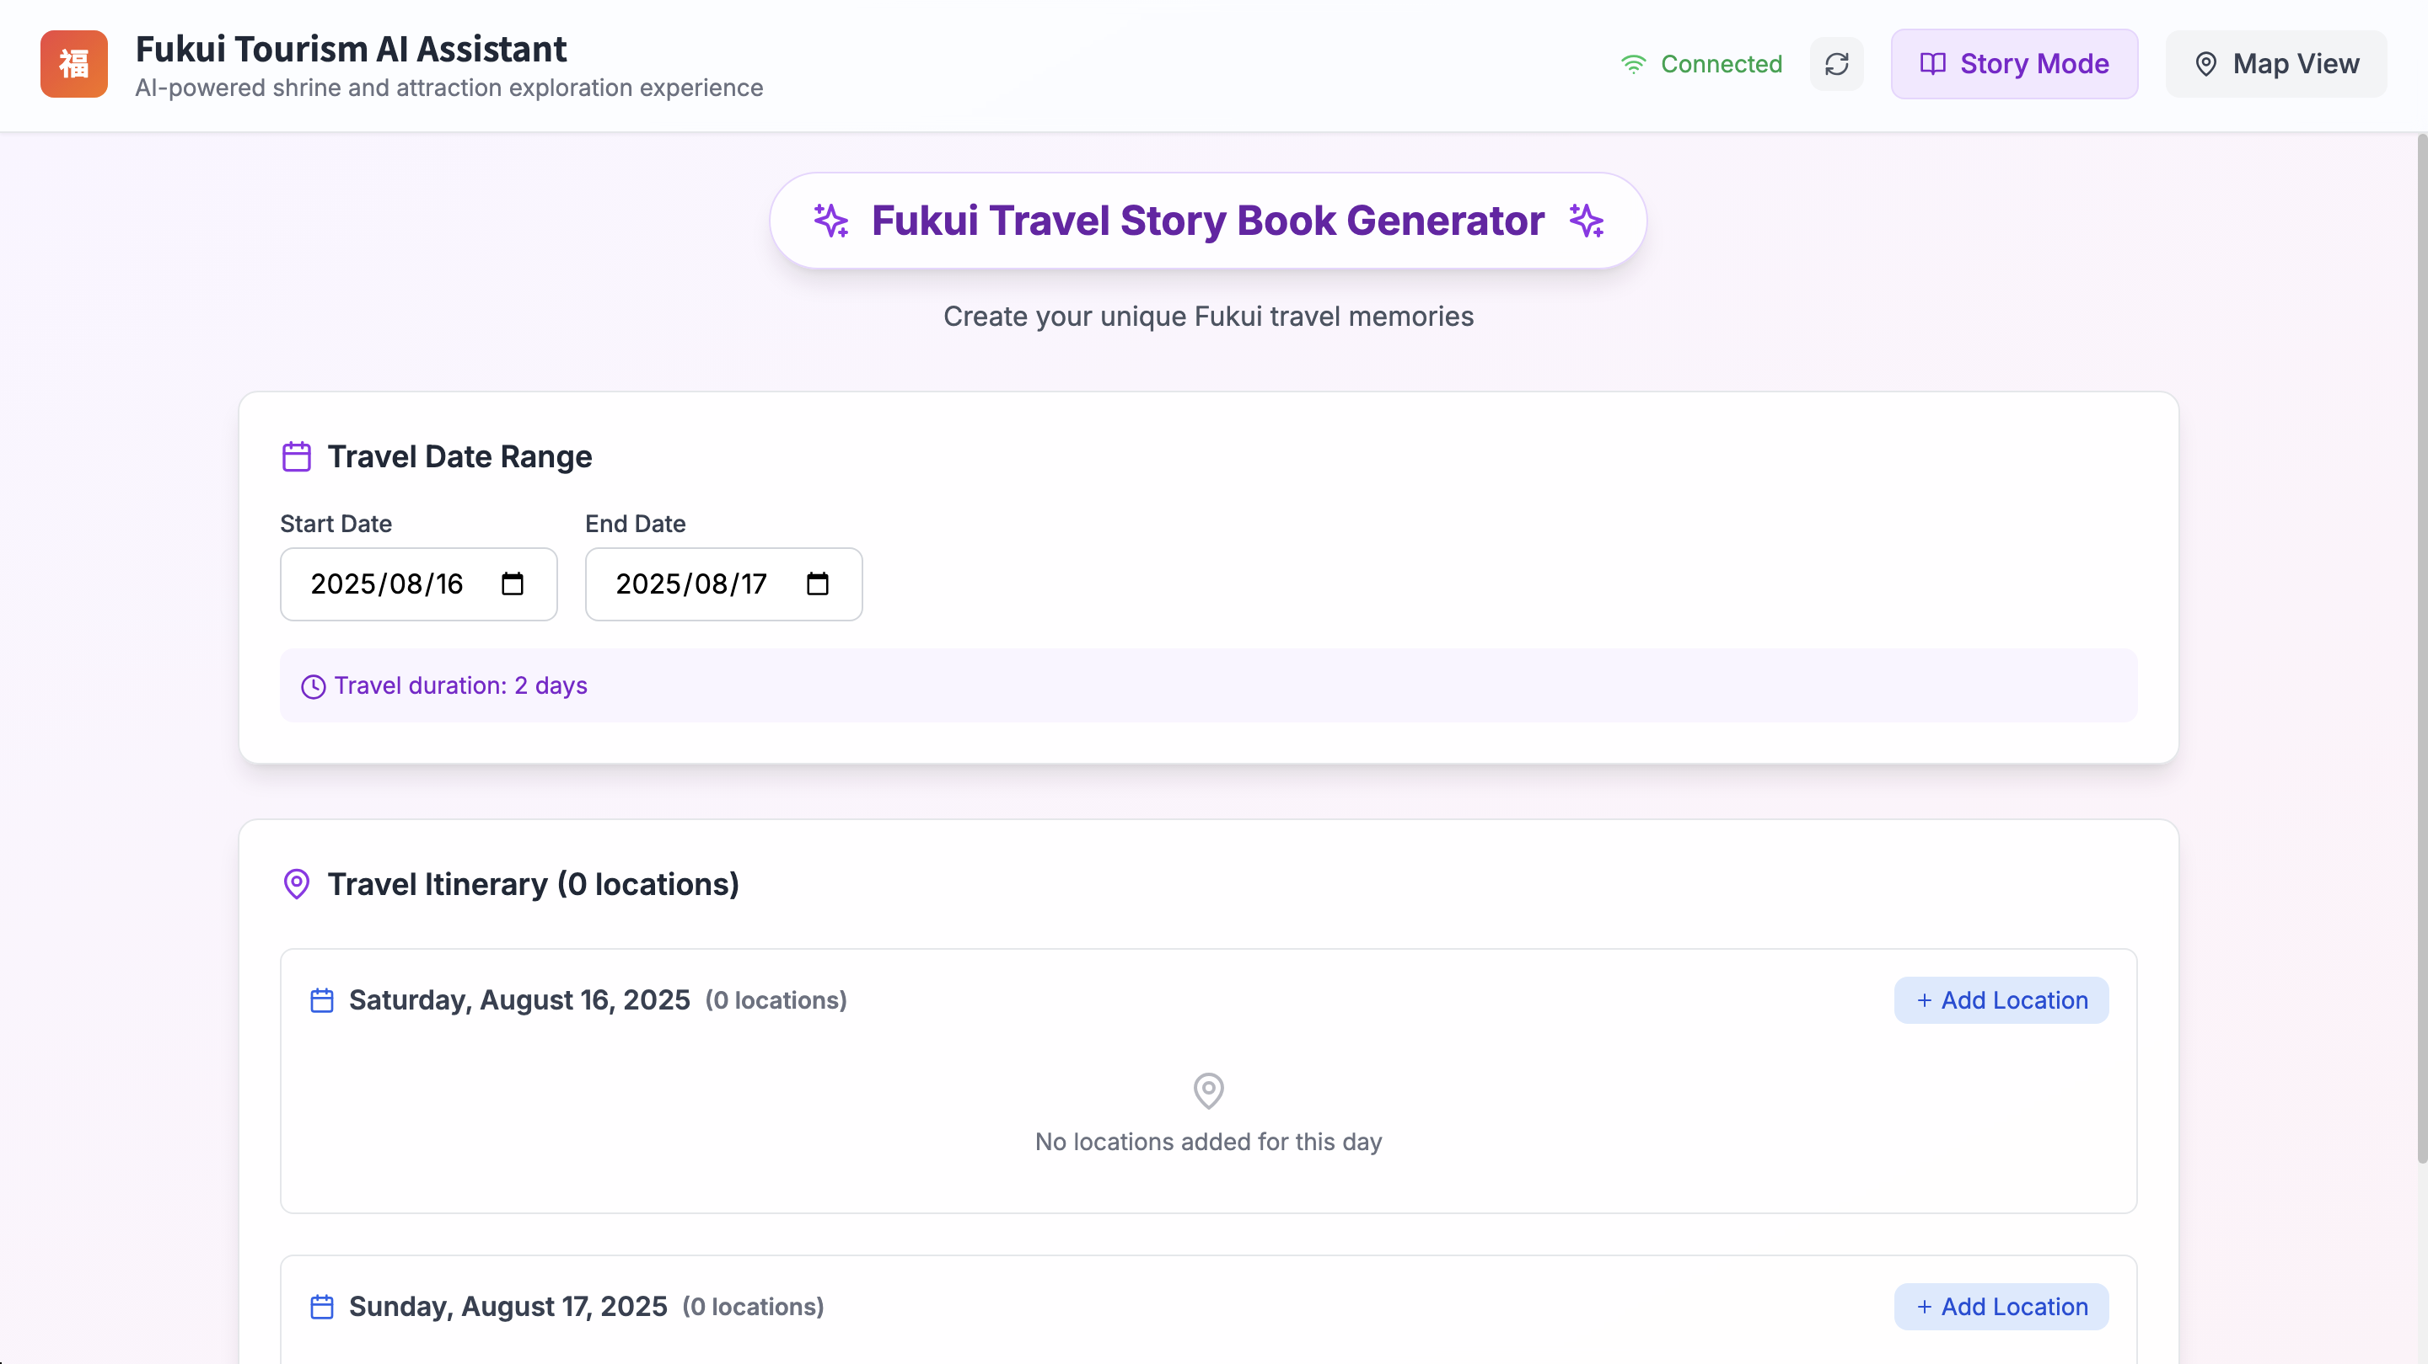
Progress
Edit Mode
Story Mode
Conclusion
User Interface – Story Mode
Build the Daily Itinerary
For each day of the trip, click "Add Location" to search and add visited spots from the database.
Notes:
設定好日期後，系統會自動為每一天建立行程表。
Once the dates are set, the system automatically creates an itinerary section for each day.
使用者可以針對特定的一天，點擊「Add Location」按鈕。
The user can click the "Add Location" button for a specific day.
接著，就能從我們的景點資料庫中，搜尋並加入該日到訪的地點。
This allows them to search for and add a visited location from our attraction database.

Slide 12
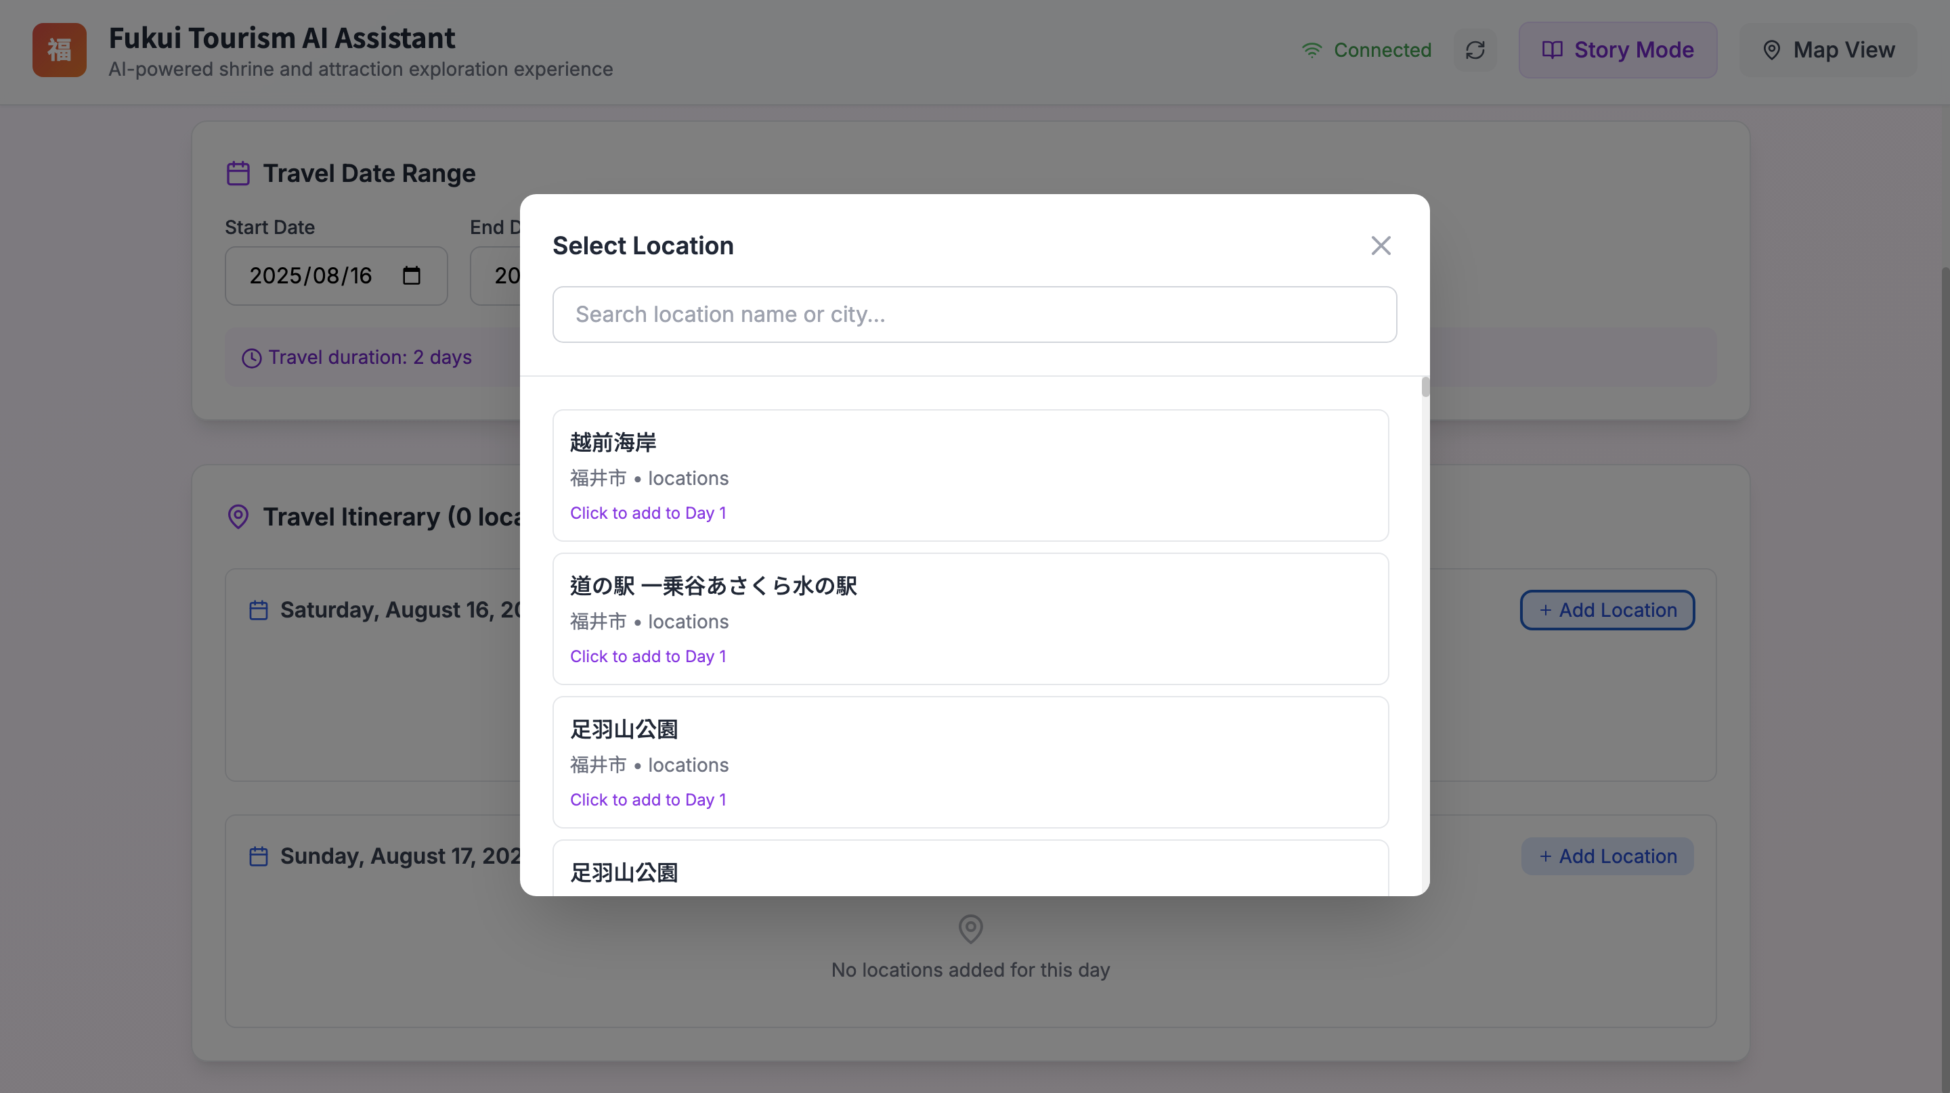
Progress
Edit Mode
Story Mode
Conclusion
User Interface – Story Mode
Select Itinerary Location
The system displays a list of locations; users can search or click directly to add a spot to the selected day's itinerary.
Notes:
點擊新增後，系統會彈出一個地點選擇視窗。
After clicking 'Add,' a location selection window appears.
這裡會列出我們資料庫中的景點，使用者可以透過搜尋來快速尋找目標。
This lists the attractions from our database, and the user can search to quickly find a specific spot.
找到景點後，只要點擊一下，就能把它加到當天的行程裡。
Once the location is found, they can add it to the day's itinerary with a single click.

Slide 13
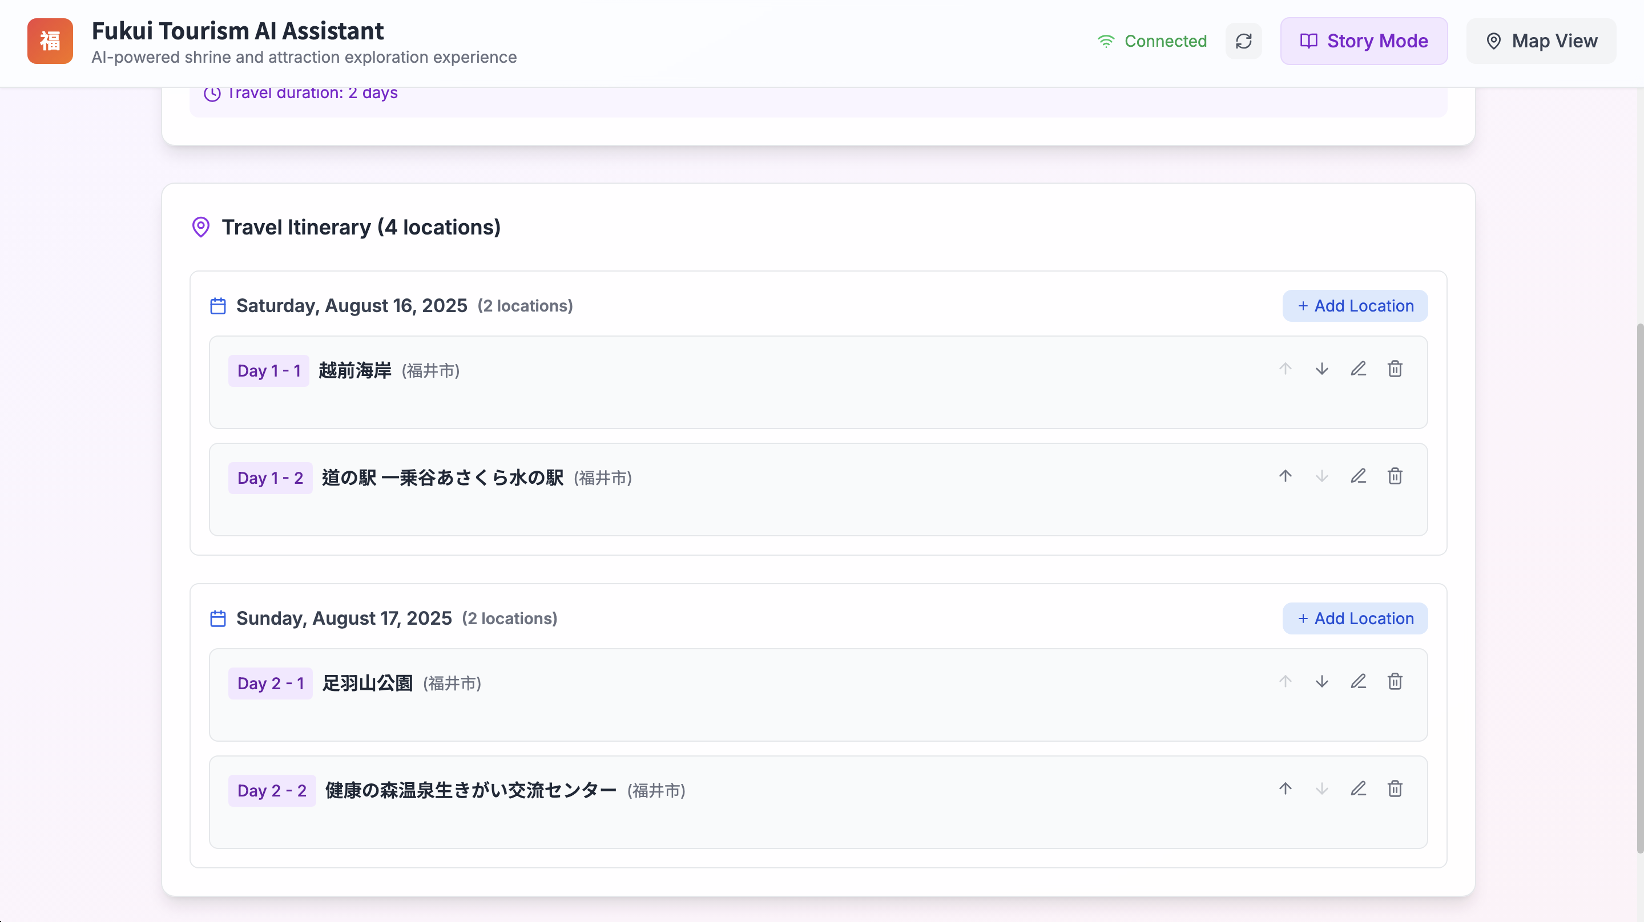
Progress
Edit Mode
Story Mode
Conclusion
User Interface – Story Mode
Itinerary Overview & Detail Editing
Once all locations are added, the system presents a complete itinerary, allowing the user to then edit the details for each spot.
Notes:
將所有景點都加入對應的日期後，這裡會顯示一份完整的行程總覽。
After all attractions have been added to their corresponding dates, a complete itinerary overview is displayed here.
這份列表清楚地呈現了每天的行程順序。
This list clearly shows the sequence of travel for each day.
下一步，使用者就可以針對列表中的任一個景點，去添加更詳細的個人化內容。
The next step is for the user to add more detailed, personalized content for each location on the list.

Slide 14
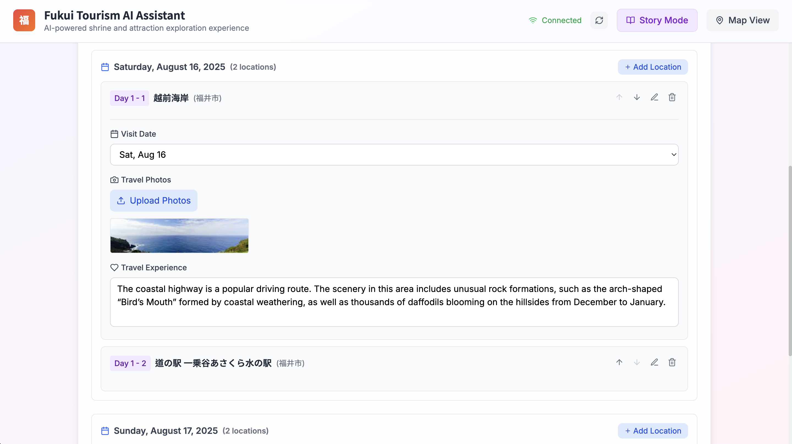
Progress
Edit Mode
Story Mode
Conclusion
User Interface – Story Mode
Add Personalized Content
Upload travel photos for each location and edit your travel experience, referencing the description provided by the system.
Notes:
點開行程中的任一地點，就可以為它添加細節。
By expanding any location in the itinerary, you can add details.
在這裡，使用者可以上傳自己實際拍攝的照片。
Here, users can upload the photos they actually took.
下方「心得」的部分，系統會先帶入該景點的介紹文字，使用者可以在此基礎上，修改成自己的旅遊心得。
In the "Experience" section below, the system prefills a description of the attraction, which users can then edit to reflect their own travel experience.

Slide 15
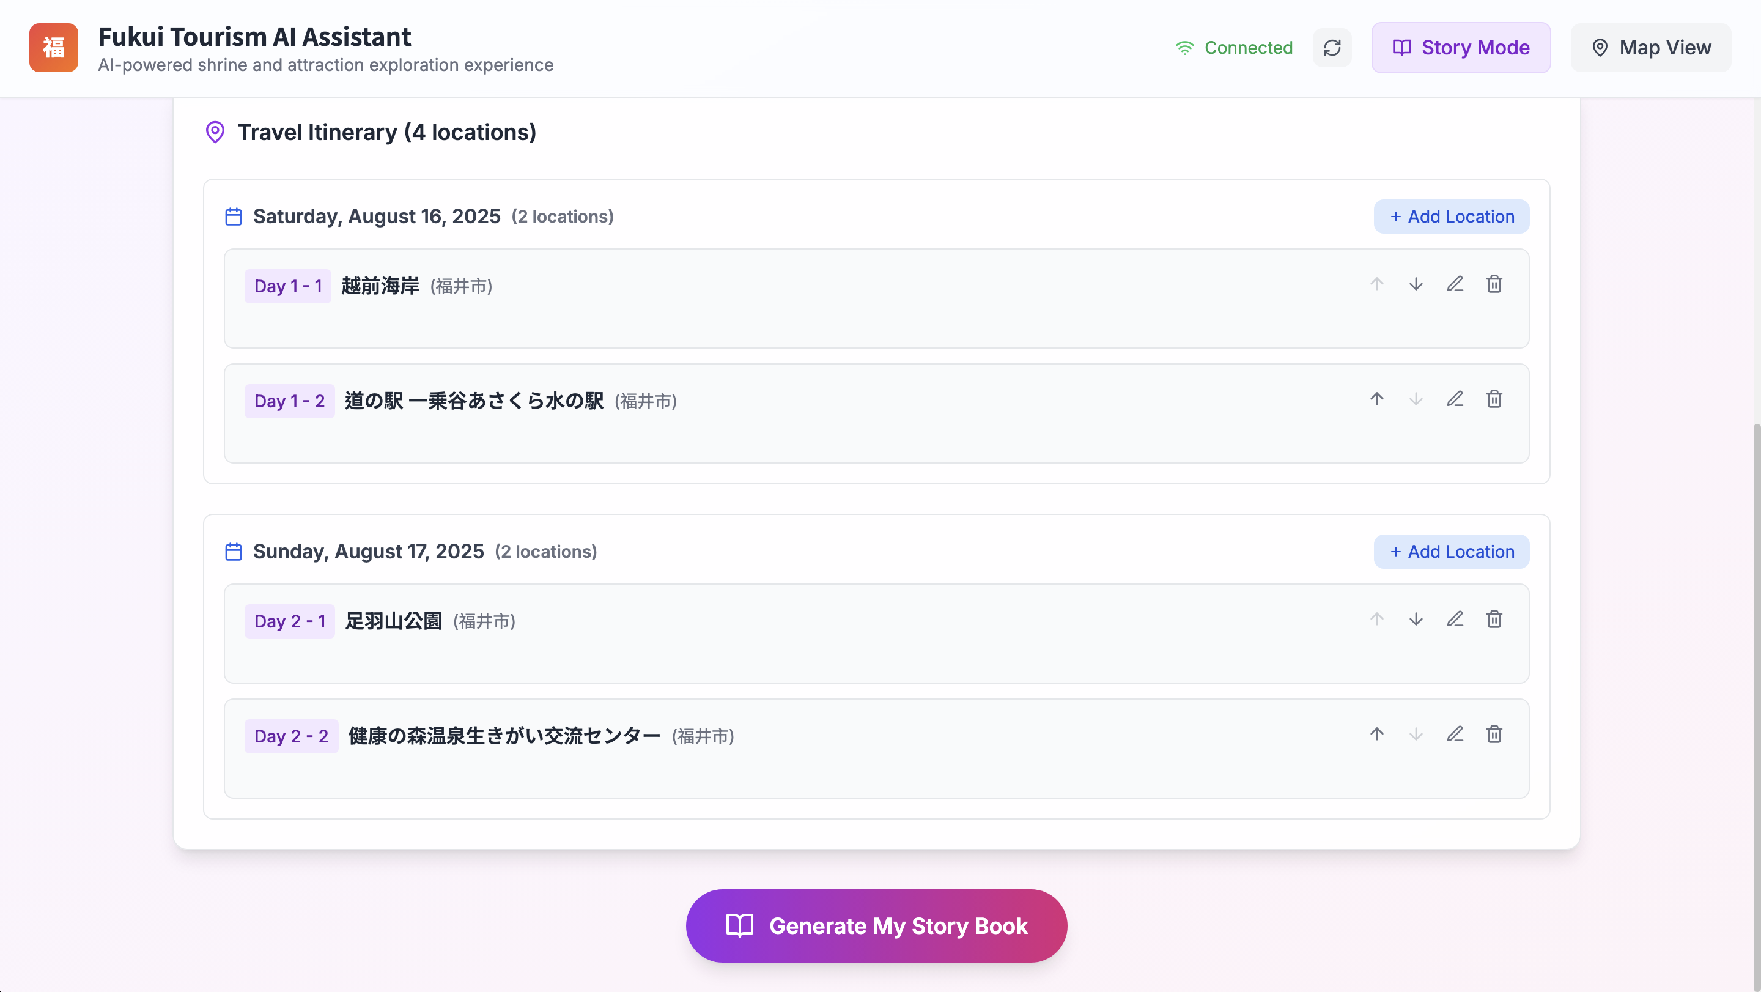

Progress
Edit Mode
Story Mode
Conclusion
User Interface – Story Mode
Generate Story with One Click
After editing the itinerary, click "Generate My Story Book," and the AI will automatically integrate all information to generate a complete travelogue.
Notes:
當使用者完成所有行程的編輯後，就可以進行最後一步。
When the user has finished editing the entire itinerary, they can proceed to the final step.
只需要點擊下方的「Generate My Story Book」按鈕。
All they need to do is click the "Generate My Story Book" button.

Slide 16
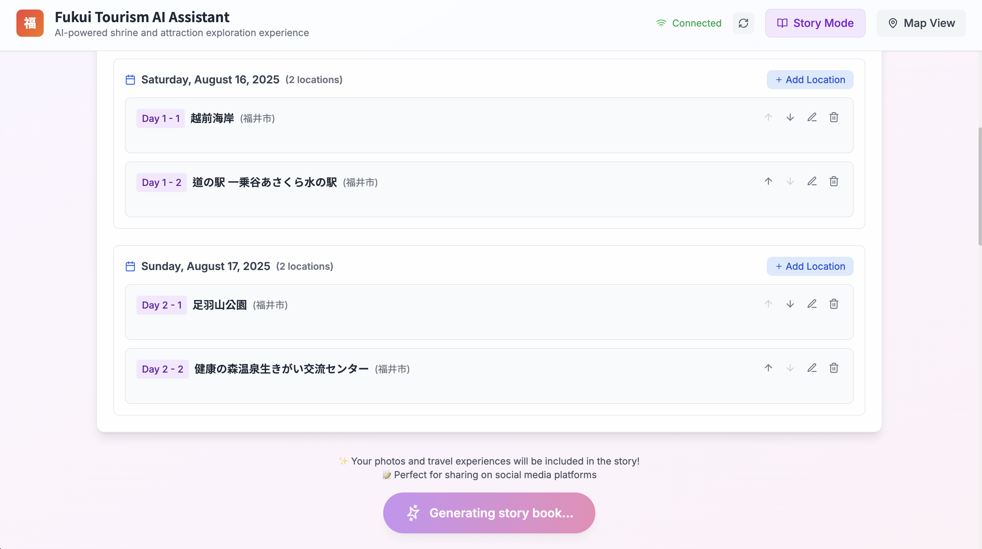
Progress
Edit Mode
Story Mode
Conclusion
User Interface – Story Mode
Generate Story with One Click
After editing the itinerary, click "Generate My Story Book," and the AI will automatically integrate all information to generate a complete travelogue.
Notes:
接著，AI 就會根據使用者提供的所有資訊——包含日期、地點順序和心得——自動生成一篇個人化的旅遊故事。
The AI will then automatically generate a personalized travel story based on all the information provided by the user, including the dates, location sequence, and personal notes.

Slide 17
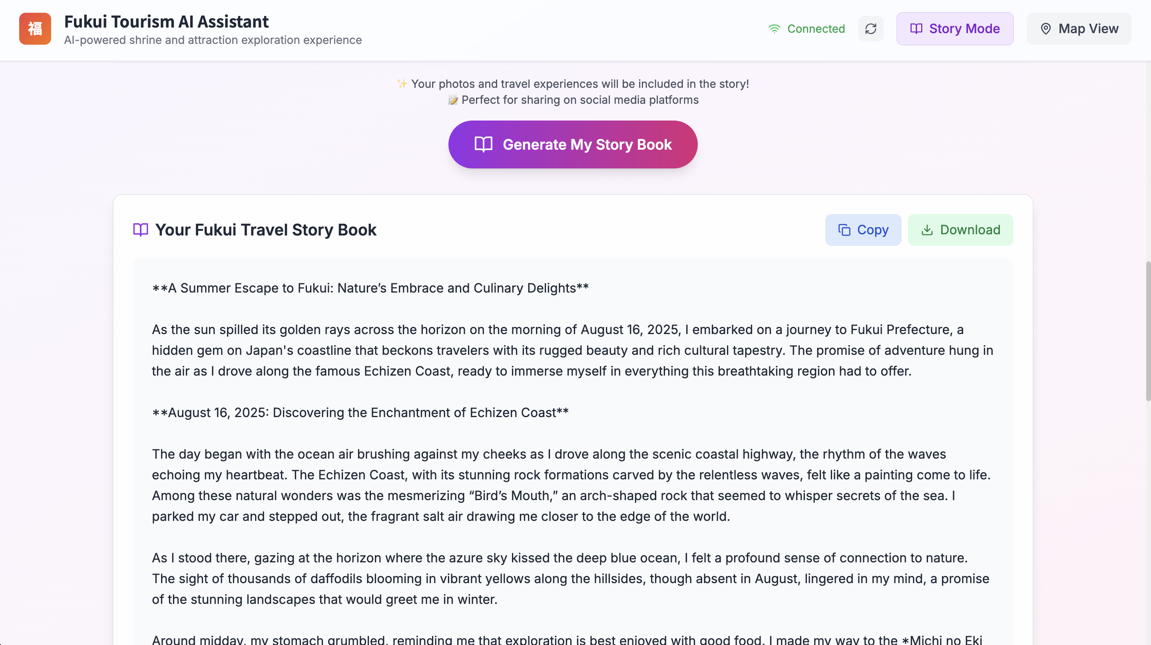
Progress
Edit Mode
Story Mode
Conclusion
User Interface – Story Mode
View the Generated Story
The AI combines the attraction database with the user's personal notes to generate a structured story, which can be copied or downloaded.
Notes:
這就是最終生成的結果：一本個人化的福井旅遊故事書。
This is the final result: a personalized Fukui travel storybook.
它的內容融合了我們系統的景點資料，以及使用者自己輸入的心得與照片。
Its content merges our system's attraction data with the user's own input, including their notes and photos.
產出的故事可以直接複製，或是下載為文字檔，方便使用者保存和分享。
The generated story can be copied directly or downloaded as a text file for easy saving and sharing.

Slide 18
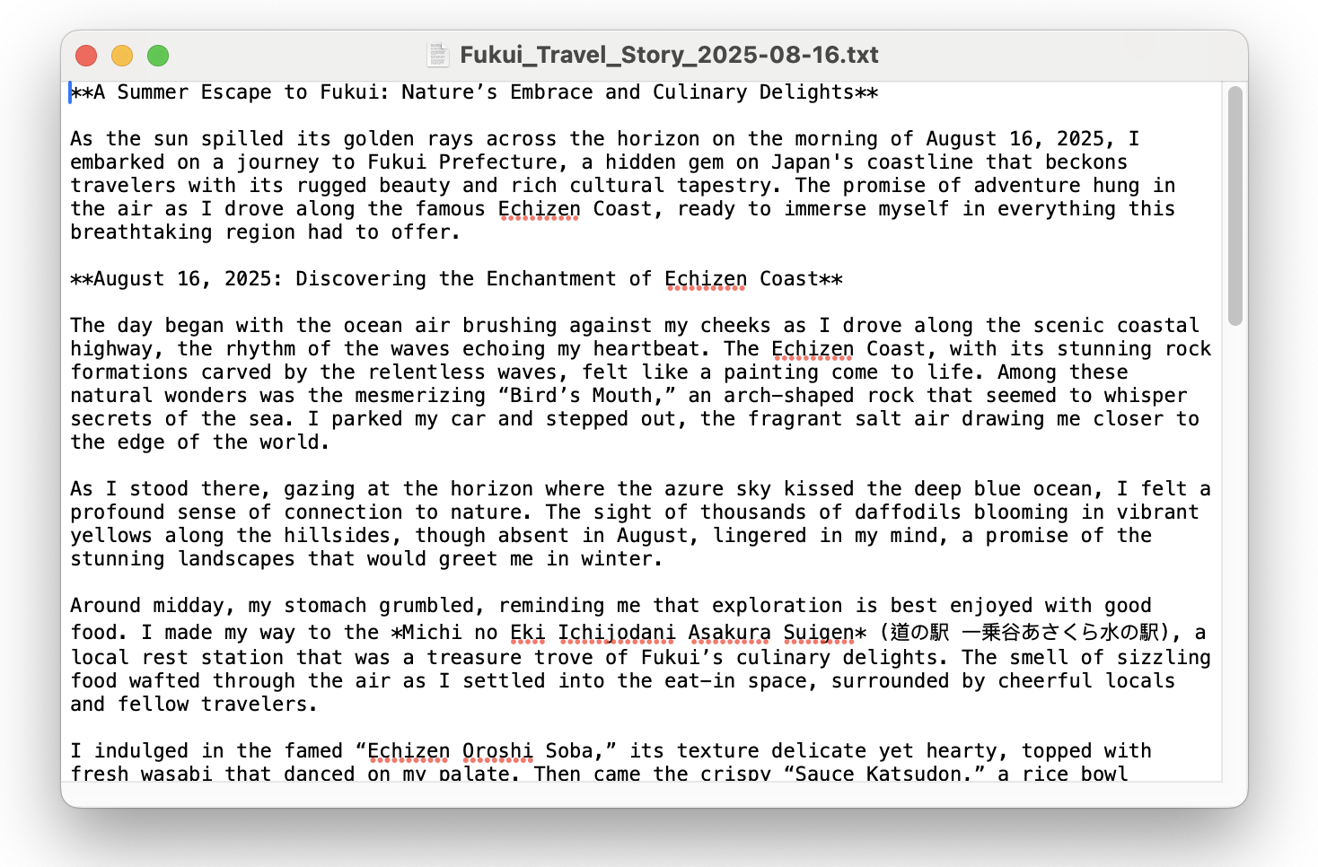
Progress
Edit Mode
Story Mode
Conclusion
User Interface – Story Mode
Export and Share the Travelogue
The system provides "Copy" and "Download" functions, allowing users to easily save the generated travelogue and share it on social media.
Notes:
整個故事的生成過程大約需要 30 秒。
The entire story generation process takes about 30 seconds.
完成後，使用者有「複製」和「下載」兩個選項。
Once complete, the user has two options: "Copy" and "Download."
點擊下載，就會得到一個如左圖所示的文字檔，這讓使用者可以很方便地將故事分享到任何社群平台。
Clicking "Download" will provide a text file, as shown on the left, making it convenient for users to share their story on any social media platform.

Slide 19
Progress
Edit Mode
Story Mode
Conclusion
This Week‘s Conclusion
From Information Tool to Content Creator: This week's new features transform the platform from a travel "information tool" into a "travel companion" where users can record and create personal memories.
Enhanced Personalization & Engagement: By allowing users to contribute personal data (Edit Mode) and generate unique content (Story Mode), we have significantly enhanced the product's level of personalization and interactive experience.
Notes:
最後，做個總結。本週的進度是我們平台一個重要的里程碑。
"In conclusion, this week’s progress is an important milestone for our platform.
透過「編輯模式」和「故事模式」，我們的應用程式不再只是一個單向的資訊提供者，而是進化成一個能與使用者共同創造價值、記錄回憶的旅遊夥伴。
"With 'Edit Mode' and 'Story Mode,' our app is no longer just giving information. It has become a travel partner that helps users keep memories.“
這不僅代表核心功能的完成，更象徵著我們成功地把產品從「查詢工具」推向「個人化創造平台」
“This not only means the core functions are complete, but also shows that we have transformed our project from a query tool into a platform for personalized creation.”

Slide 20
Thank You!
2025/08/22

Slide 21
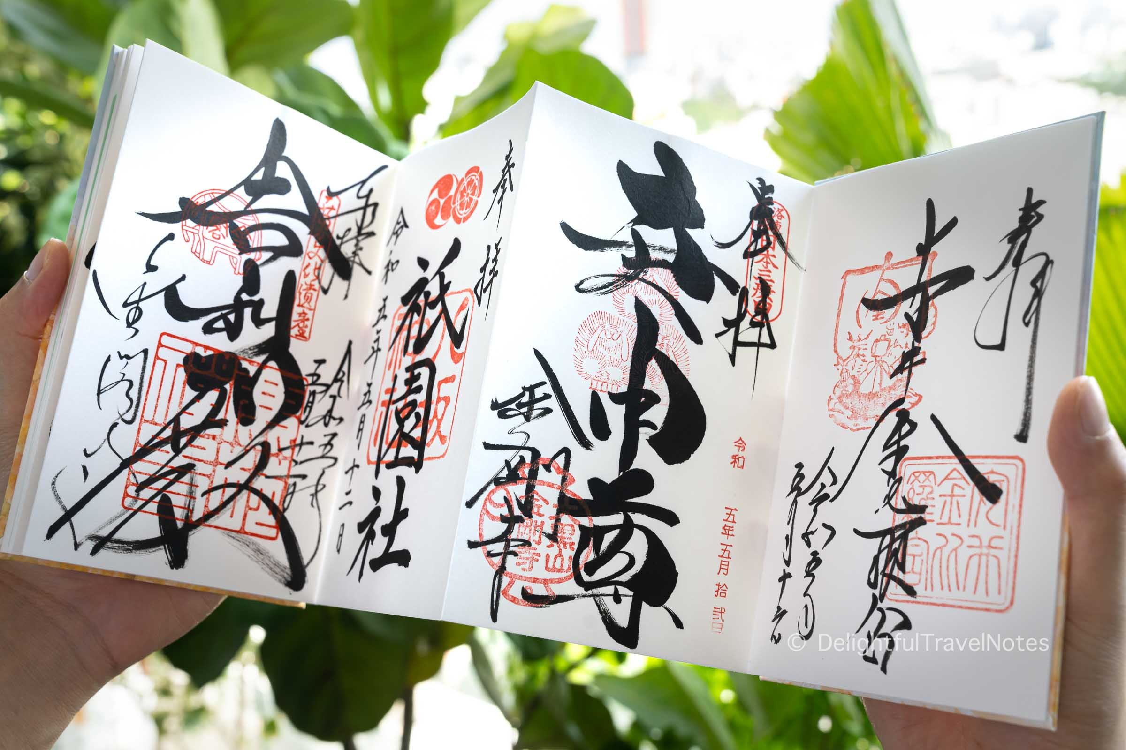



Progress
Edit Mode
Story Mode
Conclusion
In Japan, there is a practice called 御朱印(Goshuin), which serves as a proof of worship.
We Want to Implement
For Tourist to Scan ‘QR code’
/
Get the ‘Digital Goshuin’
御
朱
印
Generate By AI
Notes:
另外，我們注意到日本神社有『御朱印』這種很特別的參拜證明。
On another note, we've observed that Japanese shrines offer a unique proof of worship called a 'Goshuin.’
我們就有個想法，不知道能不能開發一個『線上御朱印』系統？讓來福井玩的旅客，可以直接掃 QR code 獲得一個數位版御朱印。
This gave us an idea: could we develop a 'digital Goshuin' system? It would allow tourists in Fukui to get a digital version simply by scanning a QR code.
不過，因為我們打算用 AI 來生成圖樣和文字，所以不太確定像御朱印這種有宗教意義的東西，這樣做會不會在信仰或傳統上產生問題
However, since we plan to use AI to generate it, we're not sure if creating a Goshuin, this way would cause any issues with faith or tradition.

